Slide 1


Indicator 14
Frequently Asked Questions
Revised
May 2010
(Revisions indicated in red font)
Notes:
Revisions are highlighted in red

Slide 2
Outcomes
Understand new Indicator 14 measurement clarifications
Review “Frequently Asked Questions” document reviewed by OSEP
Share revised Indicator 14 Interview Protocol and other resources

Slide 3

IDEA Purpose
To ensure that all children with disabilities have available to them a free appropriate public education that emphasizes special education and related services designed to meet their unique needs and prepare them for further education, employment, and independent living.
IDEA Regulations §300.1(a)
Notes:
We always start with one of the four purposes of IDEA as it forms the basis for collecting and analyzing post-school outcome data and using that information to guide program improvements.

Slide 4
NPSO Center Mission
Help State Education Agencies
develop practical, yet rigorous
data collection systems
to describe the
further education and competitive employment experiences of youth with disabilities as they transition from high school to adult life.
National Technical Assistance & Dissemination Center funded by the U.S. Department of Education Office of Special Education Programs

Slide 5

"Old" Indicator 14
Percent of youth who had IEPs, are no longer in secondary school and who have been
competitively employed,
enrolled in some type of postsecondary school,
or both
within one year of leaving
high school.
Notes:
This is the indicator States used to design their post-school outcomes systems for the SPP/APR until Feb. 2009 when OSEP released the Revised Measurement Table.

Slide 6
Revised Indicator 14
Percent of youth who are no longer in secondary school, had IEPs in effect at the time they left school, and were:
A. Enrolled in higher education within one year of leaving high school.
B. Enrolled in higher education or competitively employed within one year of leaving high school.
C. Enrolled in higher education or in some other postsecondary education or training; or competitively employed or in some other employment within one year of leaving high school.
Notes:
Indicator 14 was significantly changed and is now a “new” Indicator. The next slide highlights the major changes.
Materials related to all indicators that went into effect Feb. 2009 can be found at:
http://spp-apr-calendar.rrfcnetwork.org/explorer/view/id/620
See the following:
Revised Indicator Measurement Table
Revised Instruction Sheet
Measurement Table-Revisions/Implications Draft 02.09

Slide 7
Highlight of Changes
Feb. 2009 significant changes; May 2010 clarifications
Clarified definitions of “higher education” and “other post-secondary education or training”
Still a “New Indicator”
No reporting required FFY 2008 APR due February 1, 2010 (for students who left school in 2007-2008 school year)
New baseline reported in FFY 2009 SPP, due February 1, 2011
New baseline will represent students who left school during the 2008-09 school year
Report 3 percentages (A, B, C)
Also report numbers for each of the following: higher education, competitive employment, some other postsecondary education or training and some other employment
Report each student in only 1 of the 4 categories of the indicator-with higher education as the “highest
This presentation summarizes NPSO document entitled: Frequently Asked Questions, Part B Indicator, Post-School Outcomes, Revised May 2010
Notes:
Options for this year:
Collect PSO data on 2007-08 leavers and report with previous requirements
Collect PSO data on 2007-08 leavers, aligned with new Indicator
Not collect PSO data on 2007-08 leavers or report the data in Feb. 2010 APR, make changes and start new data collection on students leaving in 2008-09 school year
Collect the data using either set of requirements, use them for internal planning only, and not report in February 2010

Slide 8
SPP/APR Reporting Timelines
FFY | Leave High School | Collect one year out data | Report in SPP/APR
2008 | 2007-08 | Not required | Not required in Feb. 2010
2009 | 2008-09 | One year after students leave school | Feb. 2011 Use SPP template Report new baseline, target for each of the 3 percentages, and improvement activities
2010 | 2009-10 | One year after students leave school | Feb. 2012 Use APR template Report to public

Slide 9
What are the Indicator measure denominators?
For the three measures
(A, B, and C),
the denominator equals the
number of respondent leavers.
Notes:
The calculations are critical so we start there: this slide corresponds to Q 22 in FAQ. States are required to report three percentages, one each for A, B, and C.

Slide 10
What are the Indicator
measure numerators?
A-25: First calculate the following:
1 = # of respondent leavers enrolled in “higher education”
2 = # of respondent leavers in “competitive employment”
3 = # of respondent leavers enrolled in “some other postsecondary education or training”
4 = # of respondent leavers in “some other employment”
IMPORTANT:
Count each leaver in only ONE category and
only in the HIGHEST category.
Notes:
This slide corresponds to Q 23 in FAQ.
Important: each leaver is to be counted in only ONE of the 4 categories (1, 2, 3 or 4 above) and ONLY in the HIGHEST category. For Example: if a leaver is enrolled in higher education and competitively employed, count the leaver ONLY in (1) higher education and NOT in (2) competitively employed.
Remember, States are required to report three percentages, one each for A, B, and C. States are also required to provide actual numbers for 1, 2, 3, and 4.

Slide 11
Calculations
To calculate the indicator percentages, use the following:
A = 1 divided by total respondents
B = 1 + 2 divided by total respondents
C = 1 + 2 + 3 + 4 divided by total respondents

Slide 12
Here is another way to visualize it
1= # Higher Ed | 2= #Competitive Employed | 3 = #Postsecondary Education or Training | 4 = # Other Employed | # Other/Not Engaged (States are not required to report this #)
A=1/ total respondents
B=1+2/ total Respondents
C=1+2+3+4/ total Respondents
Total Respondents
Note: Remember that each leaver is only counted once and counted only in the “highest" category.
Notes:
States are not required to report those former students who were “doing something other than” or “not engaged” in 1, 2, 3, or 4. However, those leavers will be part of the “total respondents”. Some States look carefully at what is happening with students who are “not engaged” in 1, 2, 3, or 4 and target improvement efforts specifically to get those youth engaged.
States must report a percentage for each A, B, and C in the SPP/APR and to the public. States must also provide the actual numbers for each 1, 2, 3 and 4.

Slide 13
Q-2: What should states do regarding sampling?
Every district must be part of the sample during the 6 years of the SPP.
States may need to adjust their sampling plan to ensure all districts are included.
Submit revisions to OSEP for approval.
Notes:
Be sure every district will be in the sample during the course of the 6 year SPP. If a sampling State does not collect the data this year, those districts must be included before the end of the SPP.

Slide 14
Q-3: If a state conducts a census, must they describe how representative their respondents are?
Yes
Whether the state uses a sample or census, describe how respondents are similar, or dissimilar, to the target population.

Slide 15

Q-4: What is the definition of
“enrolled in higher education”?
Youth have been enrolled on a full or part time basis in a community college (2-year program) or college/university
(4- or more year program) for at least one complete term, at anytime in the year since leaving high school.
What changed? Deleted reference to Higher Education Act definition. Deleted reference to “degree” program reference to training program lasting one year to prepare for gainful employment.
Notes:
See FAQ for examples.

Slide 16

The More You Learn…the More You Earn
2007 Median Earnings: 20-25yr olds
Wagner and Cameto, 2005
Notes:
With the new Indicator 14, OSEP identifies enrollment in higher education as the gold standard…the outcome considered the “highest” after leaving high school. This is based on the reality that, in general, often the more education a person has, the higher the earnings over time.
Completing High School Increases Earning Power
<<On screen>>
Bar graph, Earning Power
*2007 Median Earnings
(Population of 20- 25 years olds and – $33,452)
Educational Attainment **Earning Power
Less than high school graduate $19,405
High school graduate $26,894
Some college or Associate’s degree $32,874
Bachelors degree $46, 805
Graduate or professional degree $61,287
*All Statistics furnished by the US Census Bureau
**In the past 13 months inflation adjusted dollars
Finishing high school really can make a difference; in dollars and in sense. It’s a fact; according to the US Census Bureau, graduates earn considerably more than students who dropout and begin a career immediately.
The employed dropout earns about $19,000 per year. Over 40 years of employment he or she will potentially earn, $1.3 million dollars less than peers with a diploma and a four year degree. In addition, the employed dropout takes 3-11 years to find initial employment and stable employment with benefits. (Wagner and Camento, 2005)

Slide 17

Q-4: What is the definition of
“enrolled in post-secondary education or training”?
Youth who have been enrolled on a full or part time basis for at least 1 complete term at any time in the year since leaving high school in an education or training program
  (e.g., Job Corps, adult education,
  workforce development program, vocational technical school which is less than a 2-year program).
What changed? In the “e.g.,” the following was added: “vocational technical school which is less than a 2-year program.”
Notes:
See FAQ for examples.

Slide 18
Q-5: How do we count a former student who is or has been enrolled in a 2- or 4-year community college, college or university in any of the following:
Remedial classes
Non-credit classes
Classes such as public speaking, art, basic skills?
All of these would be counted as higher education because they are at a 2- or 4-year college.
Notes:
See FAQ for examples.

Slide 19
Q-6: In “other postsecondary education or training,” is the list: (e.g., Job Corps, adult education, workforce development, vocational technical school which is less than a 2-year program” an exhaustive list?
No, it is not exhaustive. States may include other programs such as rehabilitative services and other programs.
Notes:
See FAQ for examples.

Slide 20
What is the definition of “competitive employment” for the purposes of this collection?
“Competitive employment” means:
  Work for pay
  At or above the minimum wage
  In a setting with others who are nondisabled
  For a period of 20 hours a week
  For at least 90 days at any time in the year since leaving high school.
  This include military employment.
Notes:
Q 23 in FAQ

Slide 21
What is the definition of “some other employment” for the purposes of this collection?
“Some other employment” means:
  Work for pay or self-employed.
  For at least 90 days at any time in the year since leaving high school.
  Includes working in a family business (e.g., farm, store, fishing, ranching, catering services, etc.).
Notes:
This differs from competitive employment in that it DOES NOT include:
at or above the minimum wage
In a setting with others who are nondisabled
For a period of 20 hours a week

Slide 22
Q-11: In the definitions for both "competitive employment' and
"some other employment", what does "at least 90 days at any time since leaving high school" mean?
“90 days” means:
Either 90 cumulative days or 3 months of continuous work at an average of 20 hours per week at any time in the year since leaving high school.
  The days need not be consecutive
  May include more than one job
Notes:
Competitive employment means that youth have worked for pay at or above the minimum wage in a setting with others who are nondisabled for a period of 20 hours a week for at least 90 days at any time in the year since leaving high school. This includes military employment.
Some other employment means youth have worked for pay or been self-employed for a period of at least 90 days at any time in the year since leaving high school. This includes working in a family business (e.g., farm, store, fishing, ranching, catering services, etc.).

Slide 23
Q-12: What does
"20 hours a week" mean?
“20 hours a week” includes:
  At least 20 hours a week for 90 cumulative days
  20 hours or more a week for 90 cumulative days
  An average of 20 hours a week for 90 cumulative days

Slide 24
Q-10: How should ‘stay at home parents’ be counted?
Stay at home parents would be counted as “not engaged” for the SPP/APR.
However, a State may choose to collect these data and report such a category if stakeholders deem this useful to system or program improvement.
Notes:
See FAQ for examples.

Slide 25
Q-15: Can a state choose to NOT include "military" as competitive employment?
NO
Military is defined as competitive employment.

Slide 26
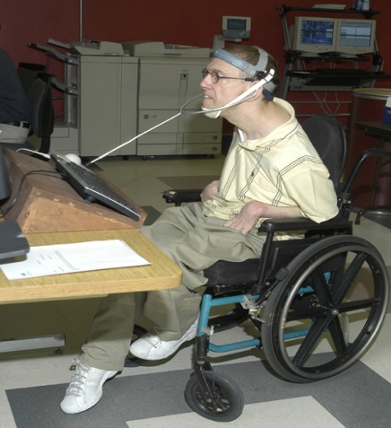

Q-16: Under "some other employment" are number of hours per week and earnings considered?
No, hours and wages are not considered.
However, the “other employment” needs to be “for a period of at least 90 days at any time in the year since leaving high school.”

Slide 27
Q-17: Does "some other employment" include sheltered and supported employment?
Yes

Slide 28
Q-18: How do you count “supported employment?”
If it meets the criteria for “competitive employment” (e.g., 90 days, averaging 20 hours/week, and is at or above minimum wage), then it counts as “competitive employment.”
If the criteria for competitive employment is not met, then it counts as “some other employment.”

Slide 29
Q-19: How do you count “self-employment?”
If “self-employment” meets the criteria for “competitive employment” (e.g., 90 days, averaging 20 hours/week, and is at or above minimum wage), then it counts as “competitive employment.”
If “self-employment” does not meet this criteria, then it counts as “some other employment.”

Slide 30
Q-20: If a youth meets all the criteria of competitive employment except they are working 16 hours per week, is that "other employment?"
Yes, this is “some other employment,”
because the youth does not meet the 20 hour/week definition of “competitive employment.”

Slide 31
Q-22: Must states set a baseline and target for each of the measures of the Indicator (e.g., A, B and C)?
Yes
Notes:
States must also provide actual numbers for 1, 2, 3 and 4 that make up A, B, and C.

Slide 32
Q-23: Are states to collect data to reflect engagement "within one year" or when "at least one year has passed?"
Data collection starts when students have been out of school at least one year and describes whether they have been enrolled in higher education, competitively employed, etc.) within one year of leaving high school.
See example scenarios… (FAQ)

Slide 33
Services, Tools, Products
Interview Protocol
Data Displays
Data Use Toolkit
And more
Deanne Unruh
dkunruh@uoregon.edu
541-346-1424
Charlotte Alverson
calverso@uoregon.edu
541-346-1390
Jim Leinen
jsleinen@uoregon.edu
541-346-0370
http://www.psocenter.org

Slide 34


Slide 35

NPSO Resources http://www.psocenter.org
Tools & Products

Slide 36


Slide 37
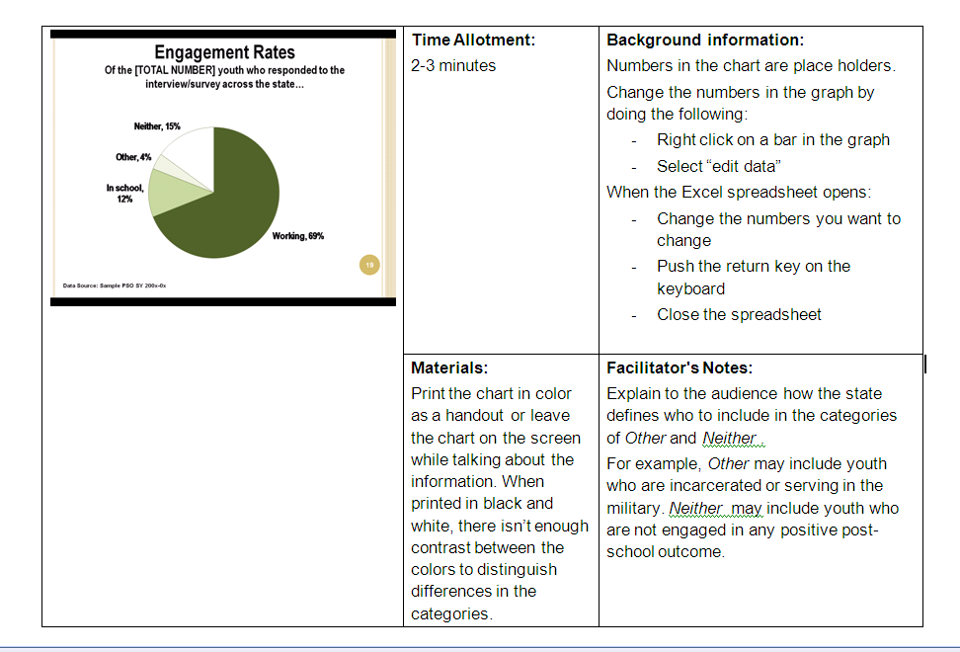
Facilitator’s Guide

Slide 38
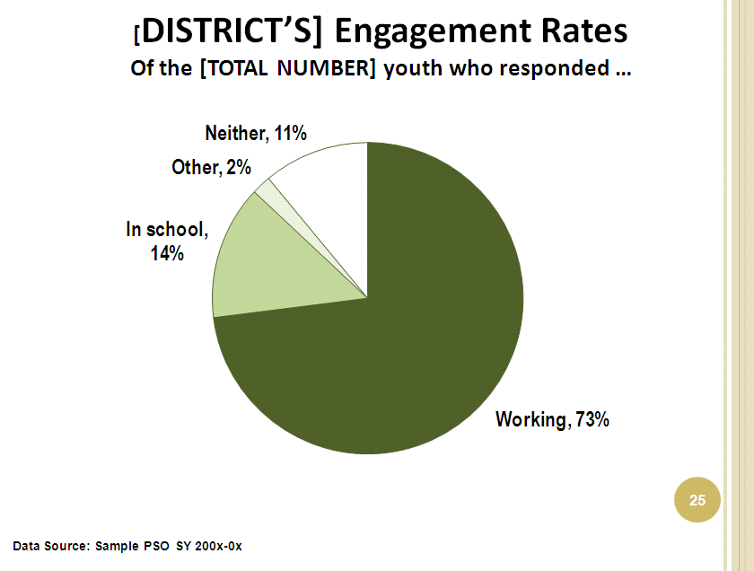
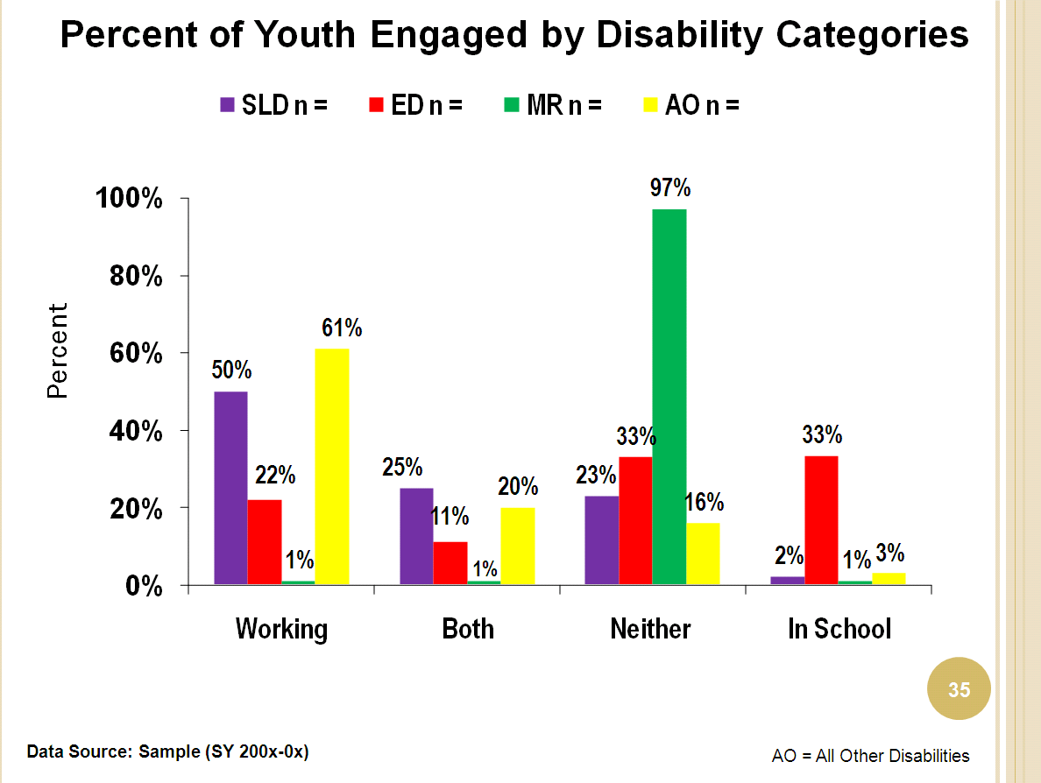
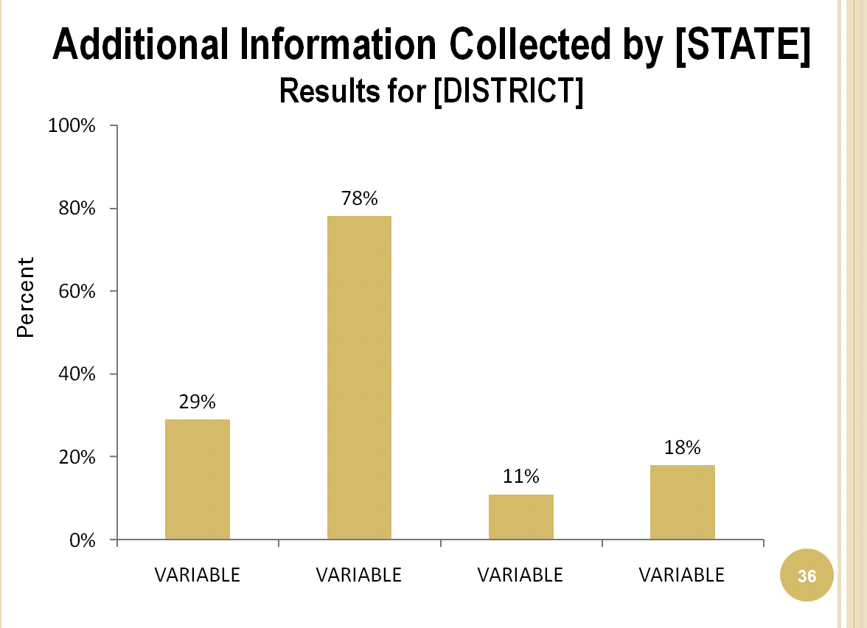
Examining Local PSO
Notes:
Screen shots of some slides from the PowerPoint.

Slide 39


Parent Informational Flyers

Slide 40


Student Flyers

Slide 41

What’s New in the Center
Working with States to incorporate Indicator 14 data into their
State
Longitudinal
Data
Systems
http://nces.ed.gov/programs/slds/
Notes:
Sponsor a series of joint meetings with collaborators to identify methods and available data for use within SLDS’s
Identify student level data elements needed to accurately report Indicator 14 in open source resources
Design a plan to support States in gathering and reporting Indicator 14 data as part of their SLDS
Implement plan with States
Provide TA to ensure SLDS systems include students with disabilities

Slide 42
http://www.psocenter.org
Notes:
Feel free to contact NPSO with questions and concerns

